Slide 1

rock:paper: scissors Game Project
Lessoons 11 and 12

Slide 2
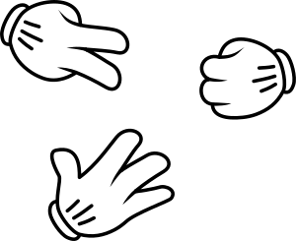
The rock:paper:scissors Game
Over the next two lessons you are going to create a game of rock:paper:scissors
The game will be played on two micro:bits
Radio blocks will be used to send and receive data between the two micro:bits
This Photo by Unknown Author is licensed under CC BY-NC

Slide 3
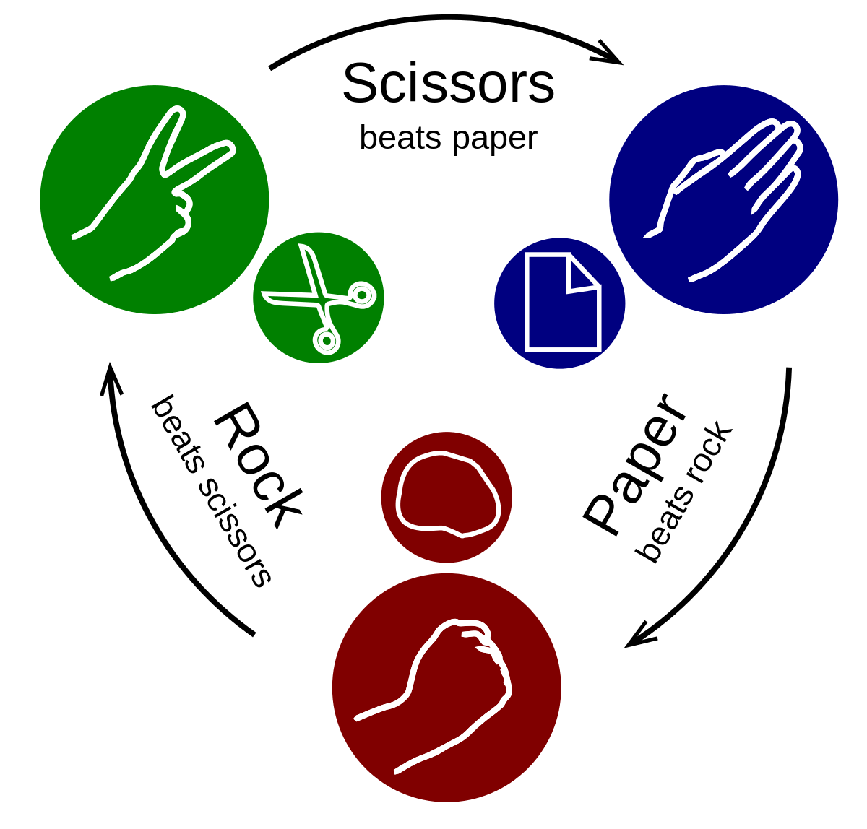
Game Logic
Before starting to develop the game it is useful to play it
With a partner you will shortly play the game
After the counting to three each player will choose whether they are rock, paper or scissors by making the relevant shape with their hand
The winner will be determined using the algorithm below:
Scissors cuts paper so scissors wins
Paper wraps rock so paper wins
Rock blunts scissors so rock wins
If both players choose the same object the game results in a draw
This Photo by Unknown Author is licensed under CC BY-SA

Slide 4
Success Criteria
Make a game where A beats B, B beats C and C beat A
The program will randomly select A, B or C when shaken
The program will transmit via radio the selection and will determine if it has won or lost the match
The program will keep count of wins and losses until reset by a button press (A and B)

Slide 5
Strap Design
The actual strap that will be used to fix the device to the player’s wrist is really important
You need to think carefully about:
The look and feel of the strap
How the micro:bit will be affixed to it
What features can be included to make it comfortable to wear
Prior to starting to make the strap you should use the ‘Wrist Strap Design’ worksheet to plan your design
You will then present your ideas to your Teacher prior to making it

Slide 6

Evaluation
Once you have completed the programming and produced the strap you should then test the game
When you are happy that the game is working as planned you may wish to attempt the Stretch Tasks
This Photo by Unknown Author is licensed under CC BY-NC-ND

